Slide 1
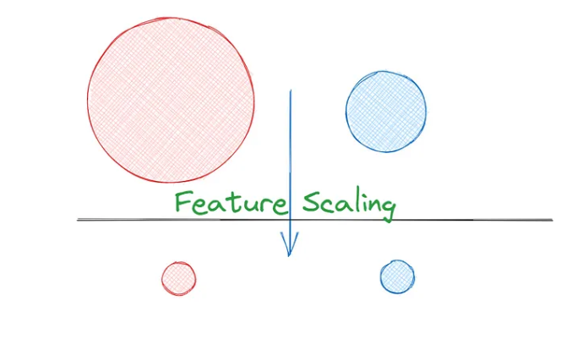
Feature Scaling
By Owais Ahmed Khan

Slide 2
Question?
Can we compare Virat kohli’s batting and Shaheen Afridi’s batting?
Notes:
Comparison can be performed between similar entities else it will be biased. Same logic applies to Machine Learning as well. Feature Scaling in Machine Learning brings features to the same scale before we apply any comparison or model building. Normalization and Standardization are the two frequently used techniques of Feature Scaling in Machine Learning.

Slide 3
What is Feature Scaling?
A method to scale numeric features in the same scale or range.
This is the last step of the feature engineering pipeline.
We apply feature scaling on independent variables
We fit the feature scaling with train data and transform on train and test data.

Slide 4
What is Feature Scaling?
In general Data set contains different types of variables having different magnitude and units (kilograms, grams, Age in years, salary in thousands etc).
The significant issue with variables is that they might differ in terms of range of values.
So the feature with large range of values will start dominating against other variables.
Models could be biased towards those high ranged features.
So to overcome this problem, we do feature scaling.
The goal of applying Feature Scaling is to make sure features are on almost the same scale so that each feature is equally important and make it easier to process by most ML algorithms.

Slide 5
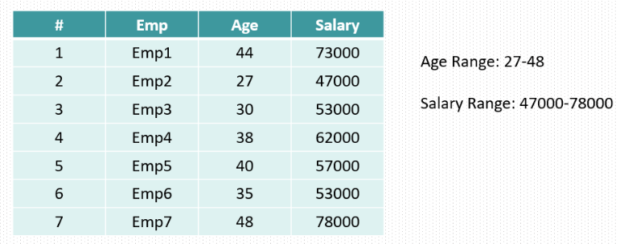
Why and how high range of features impact model performance?

Slide 6
Why and how high range of features impact model performance?
In the table both Age and Salary have different range of values.
So when we train a model it might give high importance to salary column just because the high range of values.
However it could not be the case and both columns have equal or near to equal impact on target variable which could be based on age and salary whether a person will buy a house or not.
So in case of buying a house both age and salary have equal importance.
We need to do the feature scaling.

Slide 7
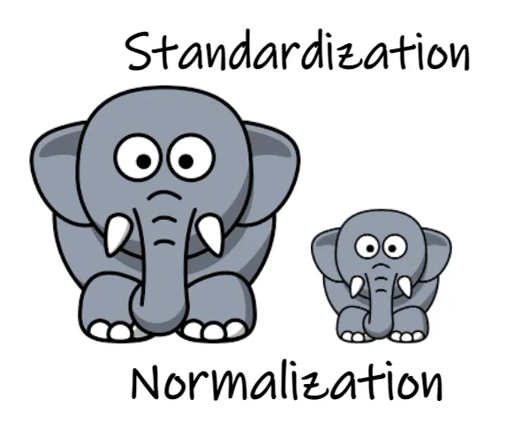
Feature Scaling Techniques
There are two mostly used feature scaling techniques.
Normalization
Standardization

Slide 8
Normalization
Normalization is also known as min-max normalization or min-max scaling.
Normalization re-scales values in the range of 0-1
Normalization is good to use when your data does not follow a Normal distribution.

Slide 9
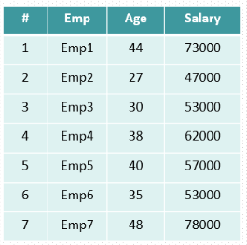
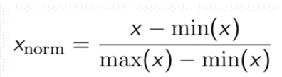
Example

Slide 10
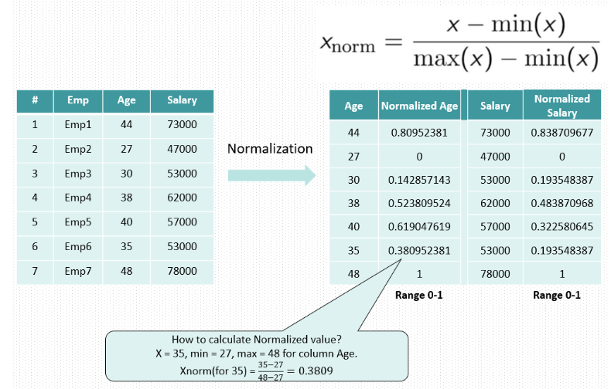

Slide 11
Standardization
Standardization or Z-Score Normalization is one of the feature scaling techniques, here the transformation of features is done by subtracting from the mean and dividing by standard deviation.
This is often called Z-score normalization.
The resulting data will have the mean as 0 and the standard deviation as 1.
Standardization, can be helpful in cases where the data follows a Normal distribution.

Slide 12
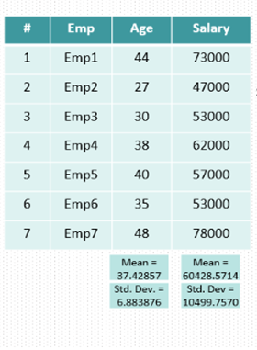


Slide 13
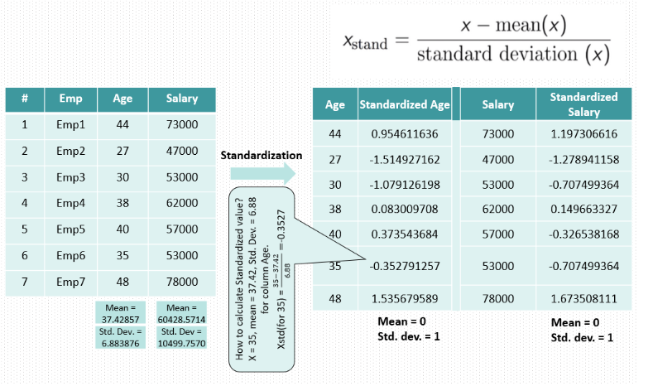

Slide 14


Slide 15
Which ML algorithms required feature scaling?
KNN
K- means
SVM
PCA
Gradient descent based algorithms (linear regression , logistic regression, NN)

